Slide 1


DEPARTMENT BES-1
  Course: Data Structures
Course code: 24sc1203
    Topic: Algorithm ANALYSIS
Session-01

Slide 2



AIM OF THE SESSION
To familiarize students with the basics of data structures, and algorithmic analysis to evaluate time complexities.
INSTRUCTIONAL OBJECTIVES
This Session is designed to:
Understand the concept of Data Structures.
Learn the Mathematical background and Model.
Analyse the algorithm to run time complexity.
LEARNING OUTCOMES
At the end of this session, you should be able to:
Evaluate the time complexities of the different Algorithmic solutions for various types of Problems.
Write the notations for calculating the running time complexity of different algorithms

Slide 3
SESSION INTRODUCTION
What is an Algorithm?
What is a Data Structure?
What is the complexity of an Algorithm?
Example of Time Complexity
What are the Different Notations?

Slide 4
ALGORITHM
A set of finite rules or instructions to be followed in calculations or other problem-solving operations
(or)
A procedure for solving a mathematical problem in a finite number of steps that frequently involves recursive operations
Set of rules to obtain the expected output from the given input
Input
Output
Algorithm

Slide 5
DATA STRUCTURE
Data Structures are used to store and organize the data in memory in an efficient manner
It is a way of arranging data on a computer to be accessed and updated efficiently.
Data Structure is used not only for organizing the data but also for processing, retrieving, and storing data.

Slide 6
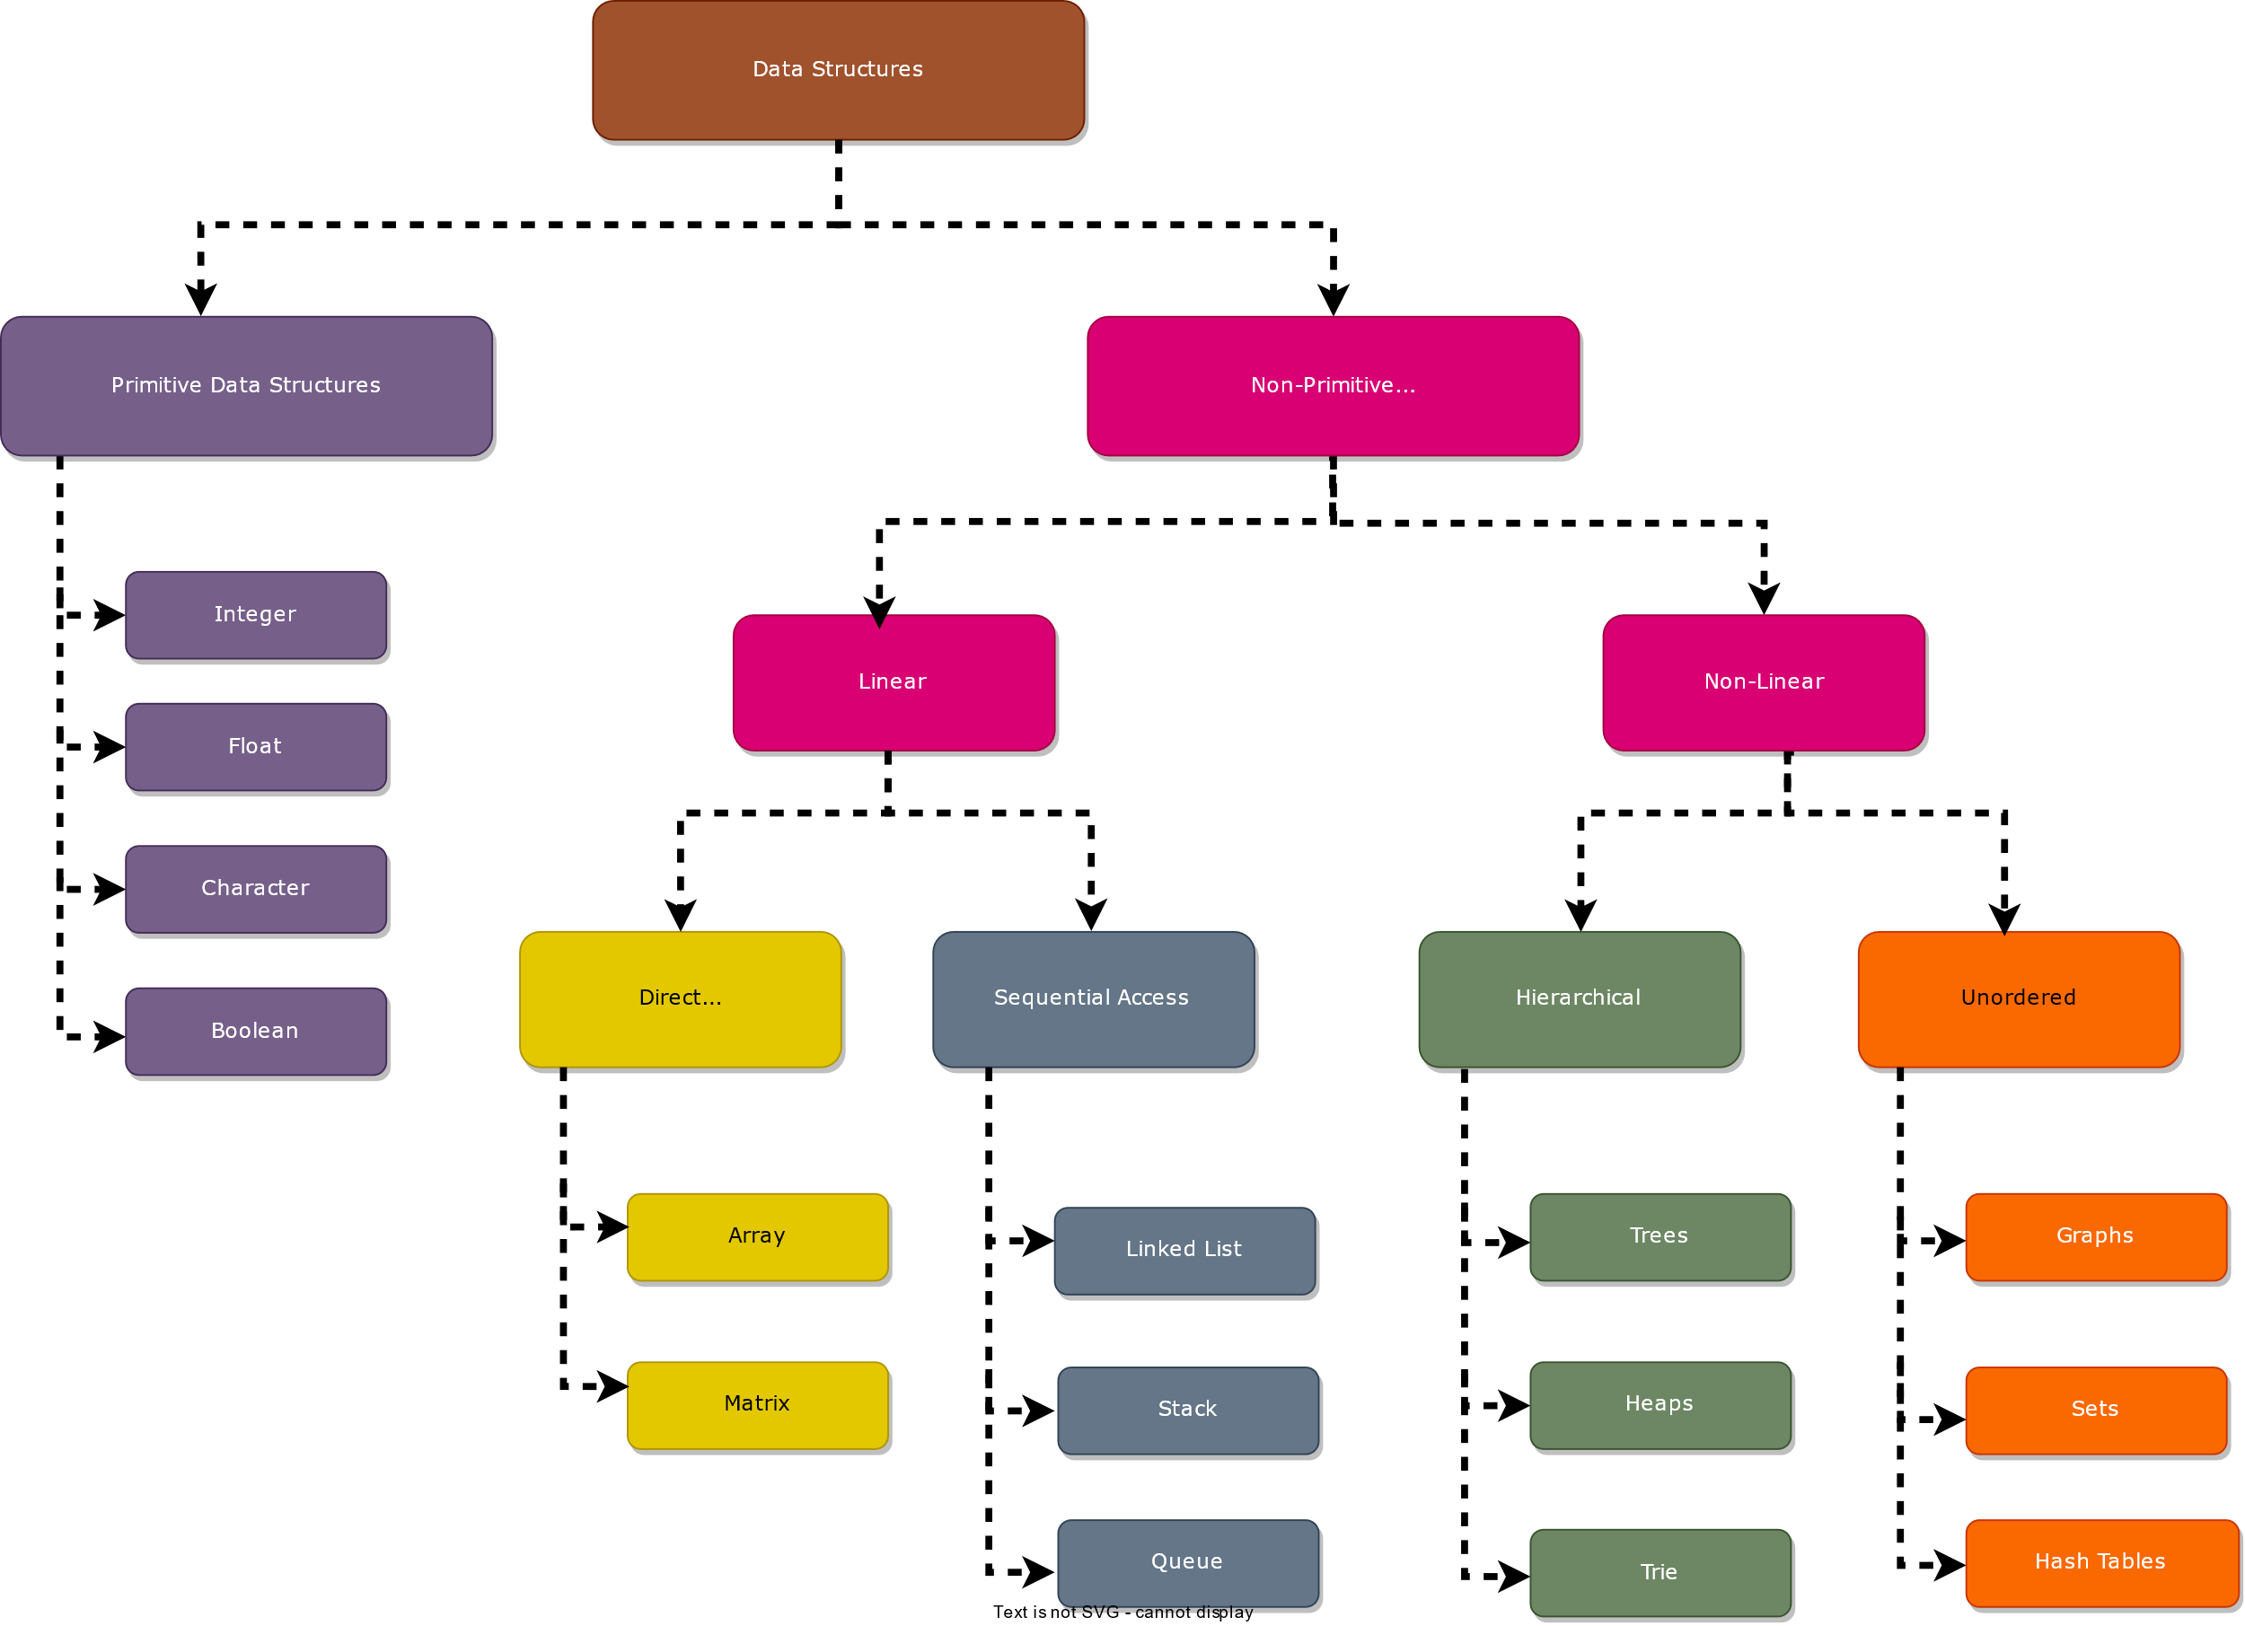
DATA STRUCTURE CLASIFICATION

Slide 7
COMPLEXITY OF AN ALGORITHM
Complexity in algorithms refers to the amount of resources (such as time or memory/Space) required to solve a problem or perform a task.
The most common measure of complexity is time complexity, which refers to the amount of time an algorithm takes to produce a result as a function of the size of the input.
Memory/Space complexity refers to the amount of memory used by an algorithm.
External Factors :
Size of input
Speed of computer
Quality of the compiler

Slide 8
TIME COMPLEXITY
Time taken by the algorithm to solve the problem.
It is measured by calculating the iteration of loops, the number of comparisons etc.
Time complexity is a function describing the amount of time an algorithm takes in terms of the amount of input to the algorithm.

Slide 9
Example (Time Complexity)
Consider the following Algorithm:
Step 1: Start → takes 0 time to run
Step 2: Declare and initialize sum and i → takes 1 time to run
Step 3: Read n value → takes 1 time to run
Step 4: Repeat Step 5 until i = n → takes n time to run
Step 5: sum+=i; → takes 1 time to run
Step 6: print sum → takes 1 time to run
Step 7: Stop → takes 0 time to run
Ans: Total time complexity = 0+1+1+(n*1)+1+1+0
= n+4
= n (remove constant terms)
Time complexity for the above algorithm is O(n)

Slide 10
Example (Space Complexity)
Suppose consider the following code:
int sum(int x, int y, int z)
{
int total = x + y + z;
return total;
}
In the above expression, variables total, x, y and z are all integer types, hence they will take up 4 bytes each, so the total memory requirement will be (4(4) + 4) = 20 bytes, this additional 4 bytes is for return value.

Slide 11
ALGORITHM ANALYSIS
ASYMPTOTIC NOTATIONS
The performance of an algorithm can change with a change in the input size
Asymptotic Notations can describe an algorithm's run time when the input tends toward a specific or limiting value.
Asymptotic analysis helps to analyze the algorithm performance change in the order of input size.
Usually, the analysis of an algorithm used for calculating the running time complexity of an algorithm is done based on three Asymptotic Notations:
    Best Case (Omega Notation (Ω))
    Average Case (Theta Notation (Θ))
    Worst Case (Big-O Notation(O))

Slide 12
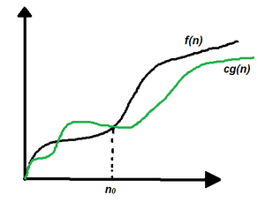
OMEGA NOTATION (Ω)
It is the formal way to represent the lower bound of an algorithm's running time.
It measures the best amount of time an algorithm can take to complete or the best-case time complexity.
Mathematical Representation of Omega notation:
Omega (Ω) notation specifies the asymptotic lower bound for a function f(n).
For a given function g(n), Ω(g(n)) is denoted by:
Ω (g(n)) = {f(n): there exist positive constants c and n0 such that 0 ≤ c*g(n) ≤ f(n) for all n ≥ n0}.
This means that, f(n) = Ω(g(n)), If there are positive constants n0 and c such that, to the right of n0 the f(n) always lies on or above c*g(n).

Slide 13
Examples
The Best Case will take place if:
  The element to be searched is on the first index.
for (int i=0; i<n; i++) → takes 1 time to run
if (arr[i] == x) → takes 1 time to run
print(i); → takes 1 time to run
The number of comparisons in this case is 1.
Therefore, the Best Case Time Complexity of Linear Search = 1*(1+1)
                = 2
                = O(1) (consider constant as 1)
Example: Let arr[]={10,20,30,40,50}
The search Element is 10
The element is found at the starting place hence time complexity is O(1)

Slide 14
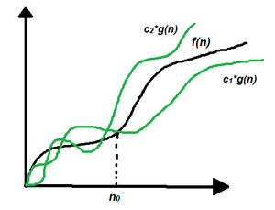
THETA NOTATION (Θ)
Every time, an algorithm does not perform worst or best, in real-world problems, algorithms mainly fluctuate between the worst-case and best-case, and this gives us the average case of the algorithm.
Mathematical Representation of Theta notation:
Theta(Θ) notation specifies a bound for a function f(n). For a given function g(n), Θ(g(n)) is denoted by:
Θ (g(n)) = {f(n): there exist positive constants c1, c2 and n0 such that 0 ≤ c1*g(n) ≤ f(n) ≤ c2*g(n) for all n ≥ n0}.
This means that, f(n) = Θ(g(n)), If there are positive constants n0 and c such that, to the right of n0 the f(n) always lies on or above c1*g(n) and below c2*g(n).

Slide 15
Examples
In average case:
Consider that the element to be searched is present in the middle of the sequence
Therefore,
The time complexity of search = n/2 *(1+1)
= n/2*2
= n
= O(n)
Example: Let arr[]={10,20,30,40,50}
The search Element is 30
The element is found at the middle, hence time complexity is O(n)
for (int i=0; i<n/2; i++) → takes n/2 time to run
if (arr[i] == x) → takes 1 time to run
print(i); → takes 1 time to run

Slide 16
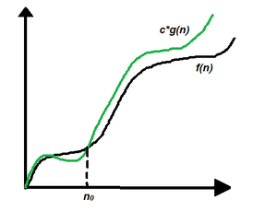
BIG-O NOTATION (O)
Big-O notation represents the upper bound of the running time of an algorithm. Therefore, it gives the worst-case complexity of an algorithm.
Mathematical Representation of Big-O notation:
Big – O (O) notation specifies the asymptotic upper bound for a function f(n).
For a given function g(n), O(g(n)) is denoted by:
O (g(n)) = {f(n): there exist positive constants c and n0 such that f(n) ≤ c*g(n) for all n ≥ n0}.
This means that, f(n) = O(g(n)), If there are positive constants n0 and c such that, to the right of n0 the f(n) always lies on or below c*g(n).

Slide 17
Examples
The worst case will take place if:
  The element to be searched is in the last index
  The element to be searched is not present in the list
  In both cases, the maximum number of comparisons take place in Linear Search which is equal to n comparisons.
Hence, the Worst Case Time Complexity of Linear Search = n*(1+1)
= n*2 (remove constant terms)
= n
= O(n).
Example: Let arr[]={10,20,30,40,50}
The search Element is 50
The element is found at the last place, hence time complexity is O(n)
for (int i=0; i<n; i++) → takes n time to run
if (arr[i] == x) → takes 1 time to run
print(i); → takes 1 time to run

Slide 18
SUMMARY
Introduction about the Algorithm and Data Structure
Calculation of the Time and Space complexity of an algorithm to find out its efficiency
Asymptotic Notations are of three types
  Big-O Notation (O)
  Theta Notation (Θ)
  Omega Notations (Ω)
Mathematical representations of the above notations
Example for each Notation

Slide 19
SELF-ASSESSMENT QUESTIONS
1. Identify the two types of efficiencies that are important for computer algorithms?
a) Time efficiency and Higher power efficiency
b) Higher power efficiency and Computational efficiency
c) Computational efficiency and Space efficiency
d) Space efficiency and Time Efficiency
2.Which one of the following asymptotic notation is used to provide lower bound constraint?
a) X
b) Ω
c) Θ
d) Ο

Slide 20
TERMINAL QUESTIONS
1. How is time complexity measured?
2. Which of the following best describes the useful criterion for comparing the efficiency of algorithms?
3. What does it mean to say that an algorithm X is asymptotically more efficient than Y?
4. Describe the various types of Asymptotic Notations with examples?

Slide 21
REFERENCES FOR FURTHER LEARNING OF THE SESSION
Reference Books:
A.V.Aho, J. E. Hopcroft, and J. D. Ullman, “Data Structures And Algorithms”, Pearson Education, First Edition Reprint2003.
Horowitz, Sahni, Anderson Freed, “Fundamentals of datastructures in C” , Second Edition-2007.
R. F. Gilberg, B. A. Forouzan, “Data Structures”, Second Edition, Thomson India Ed ition, 2005
Robert Kruse, C.L. Tondo, Bruce Leung, Shashi Mogalla, “Data Structures & Program Design in C”, FourthEdition-2007.
Sites and Web links:
  https://nptel.ac.in/courses/106102064
  https://nptel.ac.in/courses/106101060/4
  https://www.edx.org/course/algorithms-and-data-structures-1
  https://in.udacity.com/course/intro-to-algorithms--cs215
  https://www.coursera.org/learn/data-structures?action=enroll
  https://www.geeksforgeeks.org/types-of-asymptotic-notations-in-complexity-analysis-of-algorithms/

Slide 22
THANK YOU
Team – Data Structures

